Slide 1
Adaptive Near-Duplicate Detection via Similarity Learning
Scott Wen-tau Yih (Microsoft Research)
Joint work with Hannaneh Hajishirzi (University of Illinois) Aleksander Kolcz (Microsoft Bing)

Slide 2
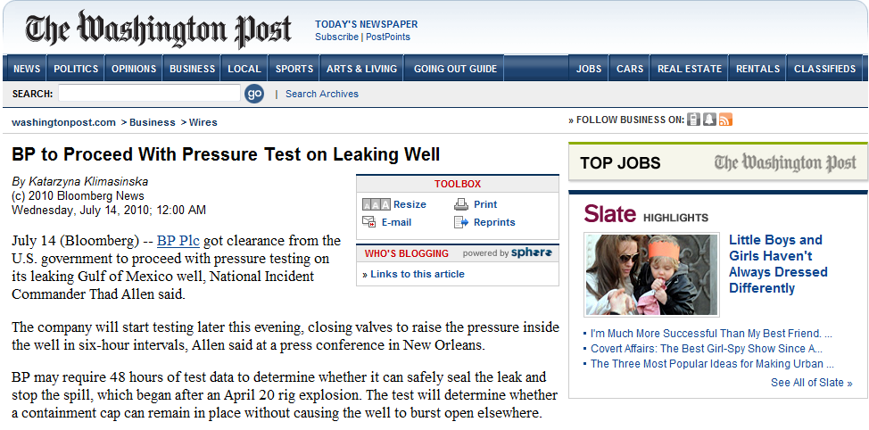
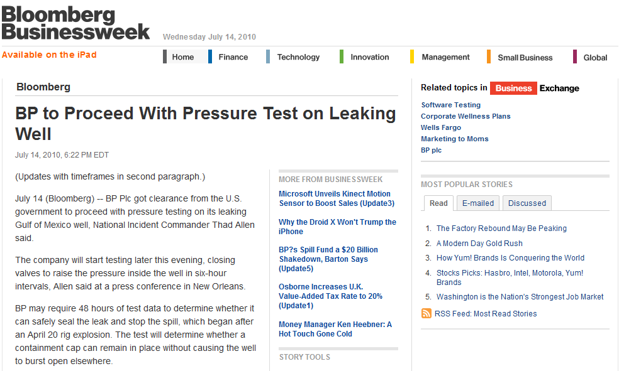
Same article

Slide 3

Subject: The most popular 400% on first deposit
Dear Player
: )
They offer a multi-levelled bonus, which if completed earns you a total o= 2400.
take your 400% right now on your first deposit
Get Started right now >>> http://docs.google.com/View?id=df67bssq_0cfwjq=x4
__________________________
Windows Live?: Keep your life in sync.
http://windowslive.com/explore?ocid=TXT_TAGLM_WL_t1_allup_explore_012009
Same payload info
Subject: sweet dream 400% on first deposit
Dear Player
: )
bets in light of the new legislation passed threatening the entire online g=ming ...
take your 400% right now on your first deposit
Get Started right now >>> http://docs.google.com/View?id=dfbgtp2q_0xh9sp=7h
_________________________________________________________________
News, entertainment and everything you care about at Live.com. Get it now=
http://www.live.com/getstarted.aspx=
Nothing can be better than buying a good with a discount.

Slide 4
Applications of Near-duplicate Detection
Search Engines
Smaller index and storage of crawled pages
Present non-redundant information
Email spam filtering
Spam campaign detection
Online Advertising
Web plagiarism detection
Not showing content ads on low quality pages

Slide 5
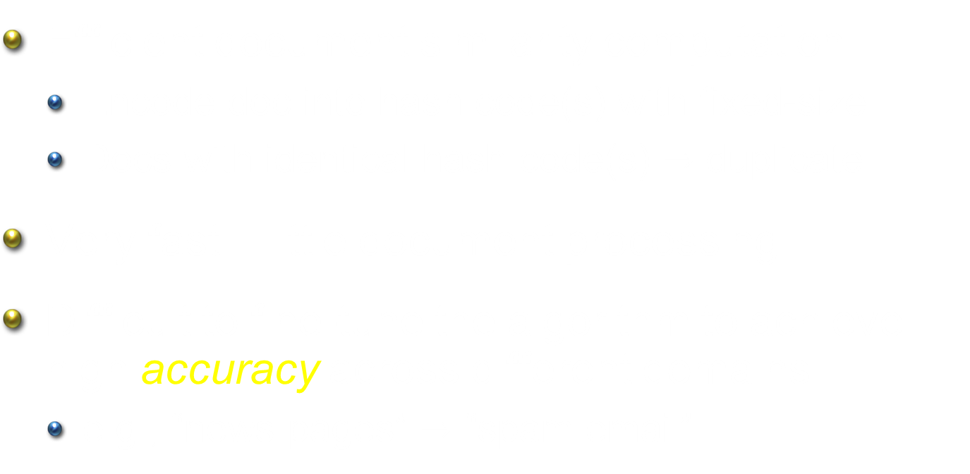
Traditional Approaches
Efficient document similarity computation
Encode doc into hash code(s) with fixed-size
Docs with identical hash code(s) $→$ duplicate
Very fast – little document processing
Difficult to fine-tune the algorithm to achieve high accuracy across different domains
e.g., “news pages” $→$ “spam email”

Slide 6
Challenges of Improving NDD Accuracy
Capture the notion of “near-duplicate”
Whether a document fragment is important depends on the target application
Generalize well for future data
e.g., identify important names even if they were unseen before
Preserve efficiency
Most applications target large document sets; cannot sacrifice efficiency for accuracy

Slide 7
Adaptive Near-duplicate Detection
Improves accuracy by learning a better document representation
Learns the notion of “near-duplicate” from (a small number of) labeled documents
Has a simple feature design
Alleviates out-of-vocabulary problem, generalizes well
Easy to evaluate, little additional computation
Plugs in a learning component
Can be easily combined with existing NDD methods

Slide 8
Outline
Introduction
Adaptive Near-duplicate Detection
A unified view of NDD methods
Improve accuracy via similarity learning
Experiments
Conclusions

Slide 9
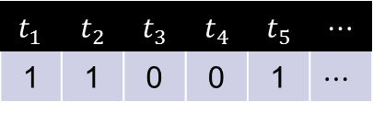








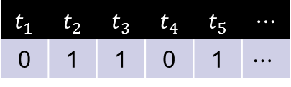


A Unified View of NDD Methods
Term vector construction ($d→d_{vec}$)
Signature generation ($d_{vec}→d_{sig}$)
Document comparison
$$d$$
$$d_{vec}$$
$$d_{sig}$$
$$t_{1}$$ | $$t_{2}$$ | $$t_{3}$$ | $$t_{4}$$ | $$t_{5}$$ | $$⋯$$
0 | 1 | 1 | 0 | 1 | $$⋯$$
AB12FE012
3458DFA15
$$Sim$$
$$f_{sim}$$
$$Overlap$$
$$d′$$
$$d_{vec}^{′}$$
$$d_{sig}^{′}$$
$$t_{1}$$ | $$t_{2}$$ | $$t_{3}$$ | $$t_{4}$$ | $$t_{5}$$ | $$⋯$$
1 | 1 | 0 | 0 | 1 | $$⋯$$
009F12485
3458DFA15

Slide 10


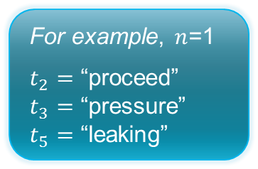
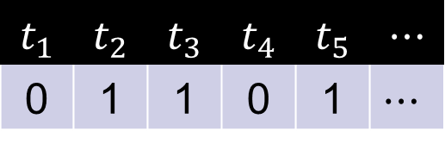
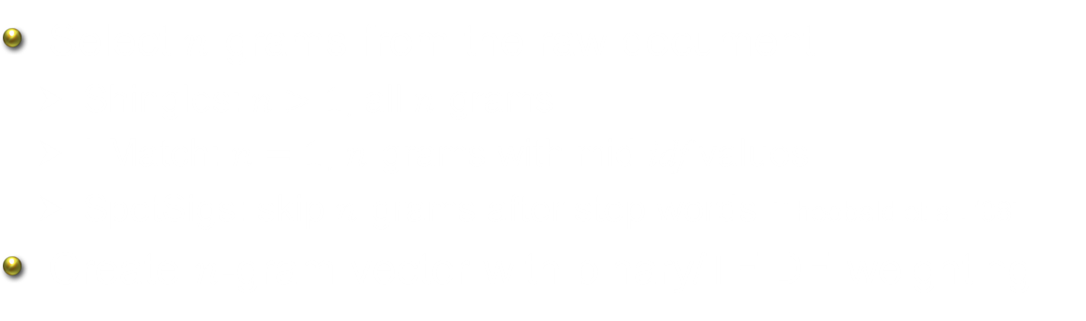


A Unified View of NDD Methods Term vector construction ($d→d_{vec}$)
Select $n$-grams from the raw document
Shingles: $n>1$, all $n$-grams
I-Match: $n=1$, $n$-grams with mid idf values
SpotSigs: skip $n$-grams after stop words [Theobald et al. ‘08]
Create $n$-gram vector with binary/TFIDF weighting
$$d$$
$$d_{vec}$$
BP to proceed with pressure test on leaking well …
For example, $n$=1
$t_{2}=$ “proceed”
$t_{3}=$ “pressure”
$t_{5}=$ “leaking”
$$t_{1}$$ | $$t_{2}$$ | $$t_{3}$$ | $$t_{4}$$ | $$t_{5}$$ | $$⋯$$
0 | 1 | 1 | 0 | 1 | $$⋯$$

Slide 11




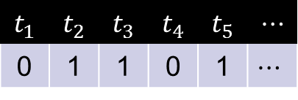
A Unified View of NDD Methods Signature generation ($d_{vec}→d_{sig}$)
For efficient document comparison and processing
Encode document into a set of hash code(s)
Shingles: MinHash
I-Match: SHA1 (single hash value)
Charikar’s random projection: SimHash [Henzinger ‘06]
$$d$$
$$d_{vec}$$
$$d_{sig}$$
$$t_{1}$$ | $$t_{2}$$ | $$t_{3}$$ | $$t_{4}$$ | $$t_{5}$$ | $$⋯$$
0 | 1 | 1 | 0 | 1 | $$⋯$$
AB12FE012
3458DFA15
009F12485
…

Slide 12






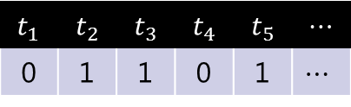


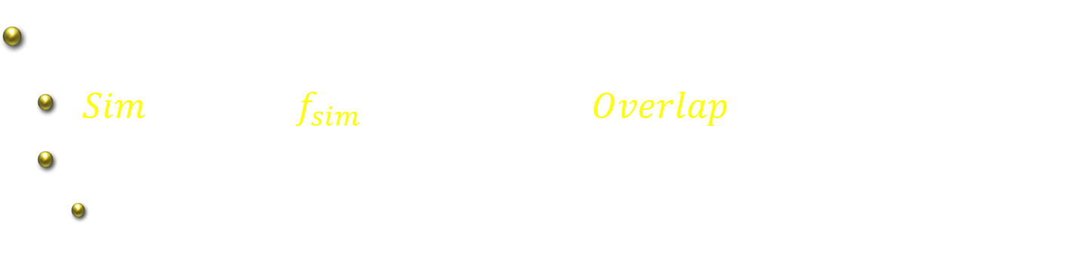
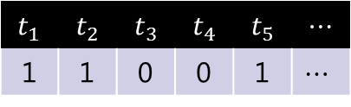

A Unified View of NDD Methods Document Comparison
Documents are near-duplicate if $Sim\left(d,d′\right)>θ$
$Sim\left(d,d′\right)≡f_{sim}\left(d_{vec},d_{vec}^{′}\right)$ $≈Overlap\left(d_{sig},d_{sig}^{′}\right)$
Signature generation schemes depend on $f_{sim}$
$f_{sim}=$ Jaccard $→$ MinHash; $f_{sim}=$ Cosine $→$ SimHash
$$d$$
$$d_{vec}$$
$$d_{sig}$$
$$t_{1}$$ | $$t_{2}$$ | $$t_{3}$$ | $$t_{4}$$ | $$t_{5}$$ | $$⋯$$
0 | 1 | 1 | 0 | 1 | $$⋯$$
AB12FE012
3458DFA15
$$Sim$$
$$f_{sim}$$
$$Overlap$$
$$d′$$
$$d_{vec}^{′}$$
$$d_{sig}^{′}$$
$$t_{1}$$ | $$t_{2}$$ | $$t_{3}$$ | $$t_{4}$$ | $$t_{5}$$ | $$⋯$$
1 | 1 | 0 | 0 | 1 | $$⋯$$
009F12485
3458DFA15

Slide 13


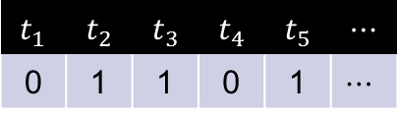
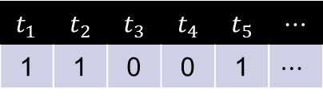







Key to Improving NDD Accuracy
Quality of the term vectors determines the final prediction accuracy
Hashing schemes approximate the vector similarity function (e.g., cosine and Jaccard)
$$d$$
$$d_{vec}$$
$$d_{sig}$$
$$t_{1}$$ | $$t_{2}$$ | $$t_{3}$$ | $$t_{4}$$ | $$t_{5}$$ | $$⋯$$
0 | 1 | 1 | 0 | 1 | $$⋯$$
AB12FE012
3458DFA15
$$Sim$$
$$f_{sim}$$
$$Overlap$$
$$d′$$
$$d_{vec}^{′}$$
$$d_{sig}^{′}$$
$$t_{1}$$ | $$t_{2}$$ | $$t_{3}$$ | $$t_{4}$$ | $$t_{5}$$ | $$⋯$$
1 | 1 | 0 | 0 | 1 | $$⋯$$
009F12485
3458DFA15

Slide 14


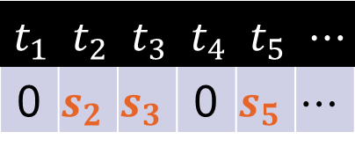
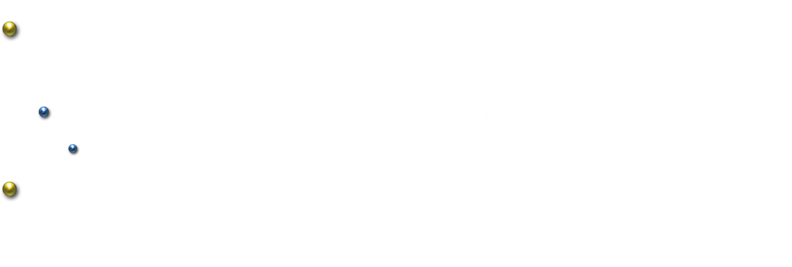
Adaptive NDD: The Learning Component
Create term vectors with different term-weighting scores
Scores are determined by $n$-gram properties
TF, DF, Position, IsCapital, AnchorText, etc.
Scores indicate the importance of document fragments and are learned using side information
$$d$$
$$d_{vec}$$
$$t_{1}$$ | $$t_{2}$$ | $$t_{3}$$ | $$t_{4}$$ | $$t_{5}$$ | $$⋯$$
0 | $$s_{2}$$ | $$s_{3}$$ | 0 | $$s_{5}$$ | $$⋯$$

Slide 15

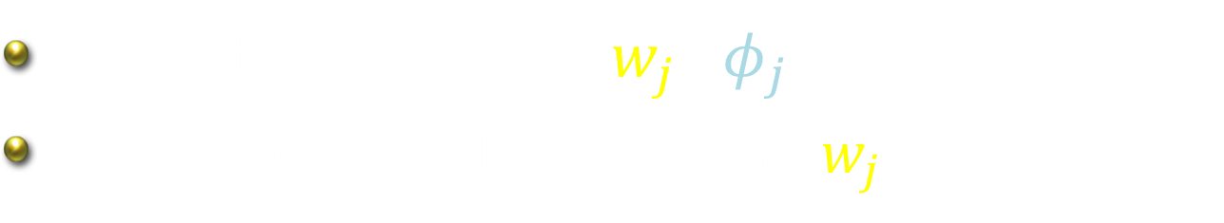

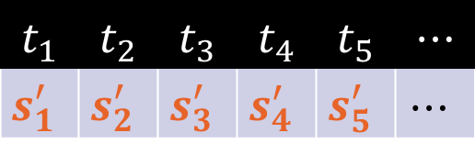


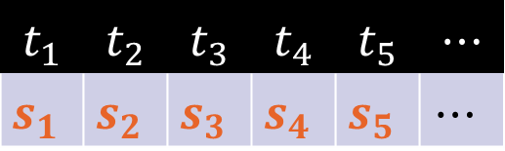
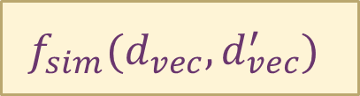
Term Vector Document Similarity
$$f_{sim}(d_{vec},d_{vec}^{′})$$
$$d_{vec}$$
$$d_{vec}^{′}$$
$$t_{1}$$ | $$t_{2}$$ | $$t_{3}$$ | $$t_{4}$$ | $$t_{5}$$ | $$⋯$$
$$s_{1}$$ | $$s_{2}$$ | $$s_{3}$$ | $$s_{4}$$ | $$s_{5}$$ | $$⋯$$
$$t_{1}$$ | $$t_{2}$$ | $$t_{3}$$ | $$t_{4}$$ | $$t_{5}$$ | $$⋯$$
$$s_{1}^{′}$$ | $$s_{2}^{′}$$ | $$s_{3}^{′}$$ | $$s_{4}^{′}$$ | $$s_{5}^{′}$$ | $$⋯$$
$$φ_{1}\left(t_{i},d\right)⋯φ_{m}\left(t_{i},d\right)$$
$$φ_{1}\left(t_{i},d′\right)⋯φ_{m}\left(t_{i},d′\right)$$
Weight of $t_{i}$: $s_{i}=\sum_{j}{w_{j}⋅φ_{j}\left(t_{i},d\right)}$
Learn the model parameters $w_{j}$

Slide 16
Features
Doc-independent features
Evaluated by table lookup
e.g., Doc frequency (DF), Query frequency (QF)
Doc-dependent features
Evaluated by linear scan
e.g., Term frequency (TF), Term location (Loc)
No lexical features used
Very easy to compute

Slide 17
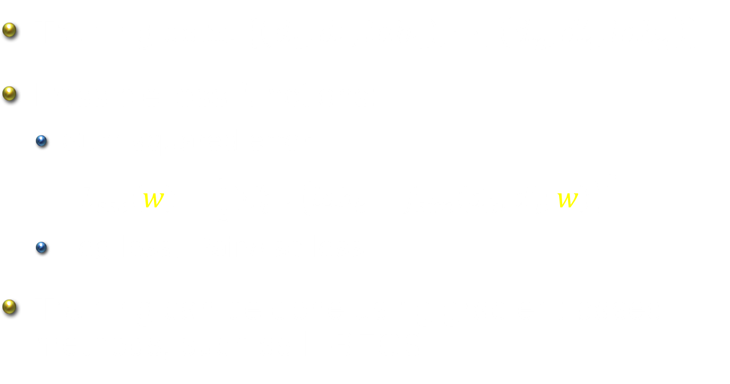
Training Procedure
Training data: $\left\{\left(d_{1},d_{1}^{′}, lab_{1}\right), ⋯,\left(d_{n},d_{n}^{′}, lab_{n}\right)\right\}$
Possible loss functions:
Sum squared error:
$L_{sse}\left(w\right)=\frac{1}{2}\sum_{k=1}^{n}{{\left(lab_{k}−f_{sim}\left(d_{k}, d_{k}^{′};w\right)\right)}^{2}}$
Log-loss, Pairwise loss
Training can be done using gradient-based methods, such as L-BFGS

Slide 18
Outline
Introduction
Adaptive Near-duplicate Detection
Experiments
Data sets: News & Email
Quality of raw vector representations
Quality of document signatures
Learning curve
Conclusions

Slide 19
Data Sets
Web News Articles (News)
Near-duplicate news pages [Theobald et al. SIGIR-08]
68 clusters; 2160 news articles in total
5 times 2-fold cross-validation
Hotmail Outbound Messages (Email)
Training: 400 clusters (2,256 msg) from Dec 2008
Testing: 475 clusters (658 msg) from Jan 2009
Initial clusters selected using Shingle and I-Match; labels are further corrected manually

Slide 20


Quality of Raw Vector Representation News Dataset
Cosine
Jaccard
Max $F_{1}$ Score
Unigram ($n=1$)

Slide 21


Quality of Raw Vector Representation Email Dataset
Cosine
Jaccard
Max $F_{1}$ Score

Slide 22

Quality of Document Signature News Dataset
Max $F_{1}$ Score

Slide 23

Quality of Document Signature Email Dataset
Max $F_{1}$ Score

Slide 24
Learning Curve (News Dataset)
Final Model
Initial Model

Slide 25
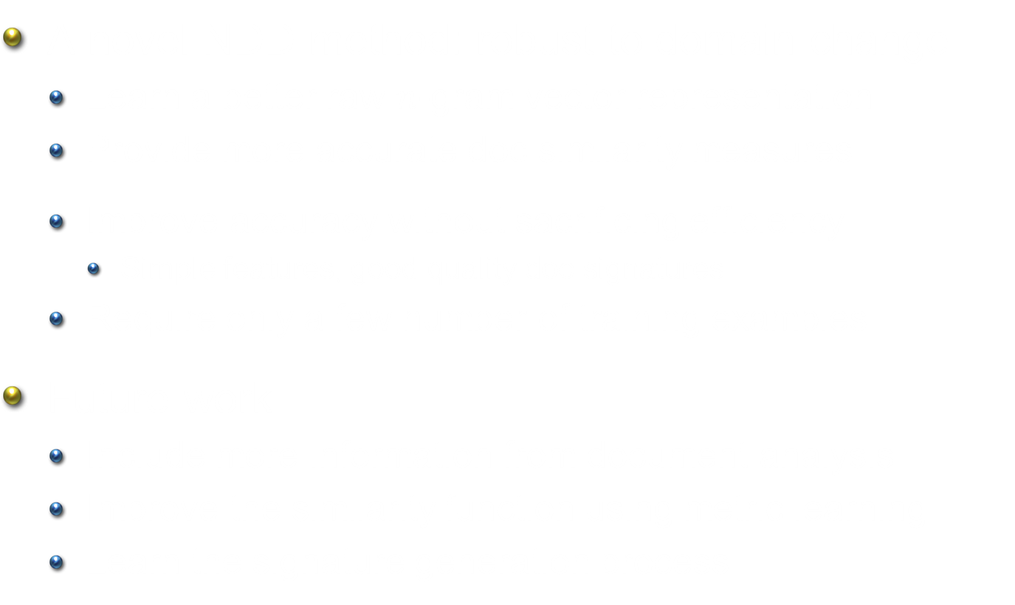
Conclusions
A novel NDD method: robust to domain change
Learn a better raw $n$-gram vector representation
Provide more accurate doc similarity measures
Improve accuracy without sacrificing efficiency
Simple features; good quality doc signatures
Require only a few number of training examples
Future work
Include more information from document analysis
Improve the similarity function using metric learning
Learn the signature generation process

